Slide 1
AREAS OF INFORMATION ARCHITECTURE

Slide 2
Architecture????
Architecture applies to various aspects of software systems development
Classification of an architecture
-from its context

Slide 3
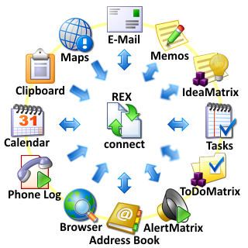

Types of Architecture
Application
Business

Slide 4
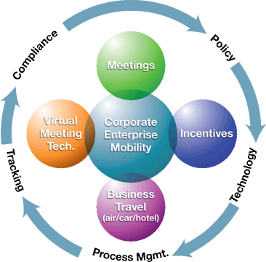
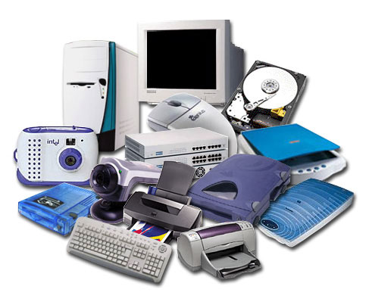
Enterprise
Hardware

Slide 5
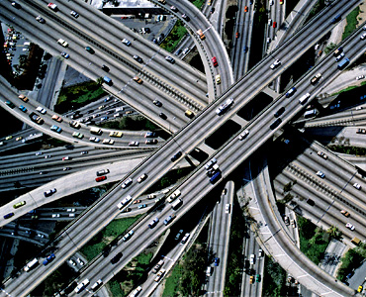

Infrastructure
Network

Slide 6


Platform
Performance

Slide 7


Security
Solution

Slide 8
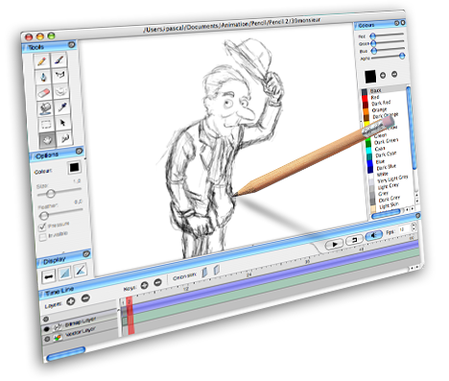

Software
System

Slide 9


Technical
Technology

Slide 10


Web
Data

Slide 11


Information

Slide 12
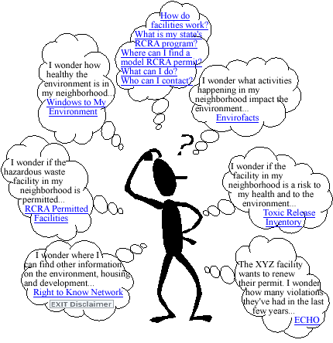

Slide 13
INFORMATION
ARCHITECTURE

Slide 14

Which solves and results in
Don’t make me think

Slide 15

HAPPY!!!!!!!!!!!!!!!

Slide 16
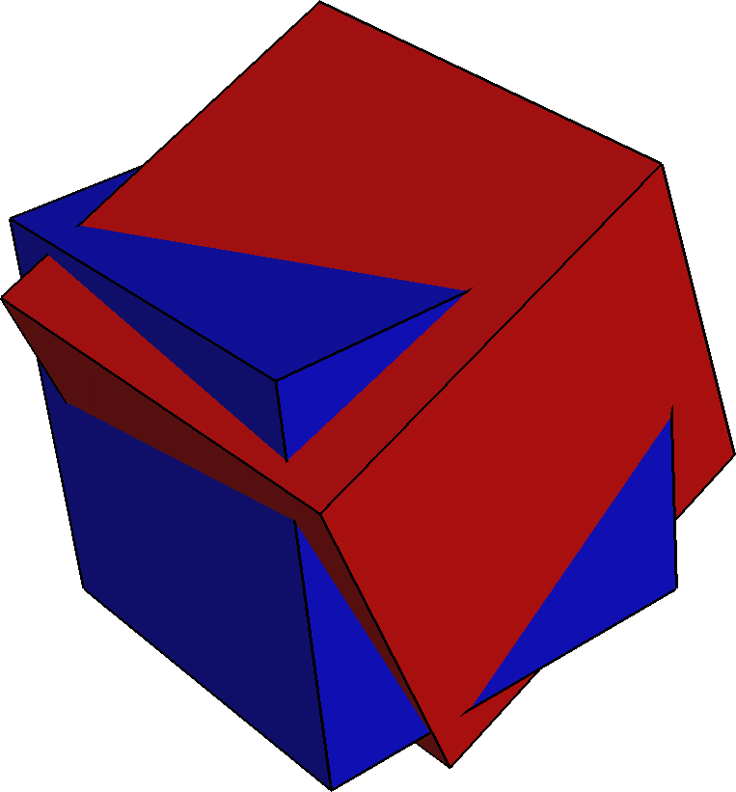
OVERLAPPING ARCHITECTURES

Slide 17
ENTERPRISE ARCHITECTURE
Enterprise Architecture is concerned with
mapping the business processes and needs to
the technical capabilities of the organization,
including personnel, strategy, distribution and
how the business changing needs will be met.

Slide 18
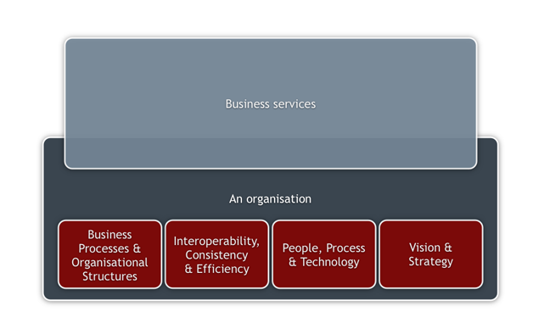

Slide 19
SYSTEM ARCHITECTURE
"System architecture" refers to the way in which
desired functionality is met by hardware and
software components as well as how these
components relate to each other and the
intended users of the system.

Slide 20
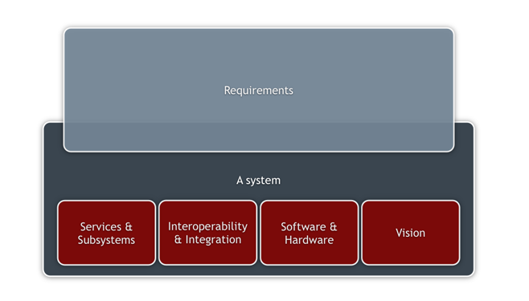

Slide 21
APPLICATION ARCHITECTURE
"Application architecture" is really a subset of
the system architecture. The scope of the
application architecture, as opposed to the
system architecture, is often determined by
business function.

Slide 22
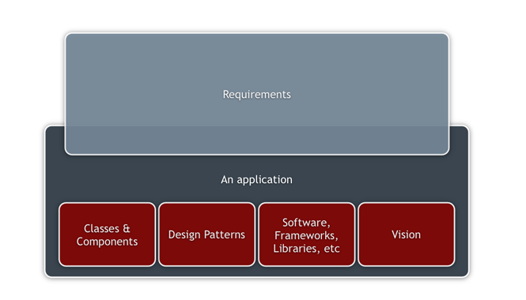

Slide 23

Queries????

